Slide 1
STRUCTURE AND UNION

Slide 2
STRUCTURE
Structure is a user-defined data type in C which allows you to combine different data types to store a particular type of record.
Structure helps to construct a complex data type in more meaningful way.
It is somewhat similar to an Array.
The only difference is that array is used to store collection of similar data types while structure can store collection of any type of data.

Slide 3
In a structure,
1. Each member declared in Structure is called member.
2. Name given to structure is called as tag.
3. Structure member may be of different data type including user defined data-type
You want to store some information about a person: his/her name, citizenship number and salary. You can easily create different variables name, citNo, salary to store these information separately.
However, in the future, you would want to store information about multiple persons. Now, you'd need to create different variables for each information per person: name1, citNo1, salary1, name2, citNo2, salary2
Since no relation between the variables (information) would exist, it's going to be a daunting task.

Slide 4
Syntax of structure
struct structure_name
{
data_type member1;
data_type member2;
.
.
data_type memeber;
};
We can create the structure for a person as mentioned above as:
struct person
{
char name[20];
int citNo;
float salary;
};

Slide 5
Structure variable declaration
struct person
{
char name[20];
int citNo;
float salary;
};
void main()
{
struct person person1, person2;
}
Another way of creating a structure variable is:
struct person
{
char name[50];
int citNo;
float salary;
} person1, person2;

Slide 6
Initialization of structure data members
struct Patient
{
float height;
int weight;
int age;
};
struct Patient p1 = { 180.75 , 73, 23 }; //initialization
or
struct patient p1;
p1.height = 180.75; //initialization of each member separately
p1.weight = 73;
p1.age = 23;

Slide 7
Accessing members of a structure
#include <stdio.h>
#include <string.h>
struct student
{
int id;
char name[20];
float percentage;
} record;
int main()
{
record.id=1; //struct student record={1,"Raju",86.5};
strcpy(record.name, "Raju");
record.percentage = 86.5;
printf(" Id is: %d \n", record.id);
printf(" Name is: %s \n", record.name);
printf(" Percentage is: %f \n", record.percentage);
return 0;
}

Slide 8
output
Id is: 1
Name is: Raju
Percentage is: 86.500000

Slide 9
Array of Structure
struct employee {
char ename[10];
int sal;
};
struct employee emp[5];
int i,j;
void ask() {
for(i=0;i<2;i++) {
printf("\nEnter %dst employee record\n",i+1);
printf("\nEmployee name\t");
scanf("%s",emp[i].ename);
printf("\nEnter employee salary\t");
scanf("%d",&emp[i].sal); }
printf("\nDisplaying Employee record\n");
for(i=0;i<2;i++) {
printf("\nEmployee name is %s",emp[i].ename);
printf("\nSlary is %d",emp[i].sal);
} }
void main() {
clrscr();
ask();
getch(); }

Slide 10
output
Enter 1st employee record
Employee name Deepti
Enter employee salary 50000
Enter 2st employee record
Employee name Shubham
Enter employee salary 80000
Displaying Employee record
Employee name is Deepti
Salary is 50000
Employee name is Shubham
Salary is 80000

Slide 11
typedef
typedef struct employee
{
char name[50];
int salary;
} emp ;
void main( )
{
emp e1;
printf("\nEnter Employee record\n");
printf("\nEmployee name\t");
scanf("%s",e1.name);
printf("\nEnter Employee salary \t");
scanf("%d",&e1.salary);
printf("\nstudent name is %s",e1.name);
printf("\nroll is %d",e1.salary);
getch();
}

Slide 12
Structures within structures
Structures can be nested within other structures in C programming.
You can use a structure inside another structure, which is fairly possible.
As explained you above that once you declared a structure, the struct struct_name would act as a new data type so you can include it in another struct just like a normal data member of any data type.

Slide 13
#include <stdio.h>
struct date
{ int month; int day; int year;
};
struct student
{ char name[80];
char address[80];
int roll_no;
char grade;
float marks;
struct date d1; }st[10];

Slide 14
void main()
{ int i,n;
void readinput (int i);
void writeoutput(int i);
printf("Student system");
printf("How many students are there ?"); scanf("%d",&n);
for (i=0; i<n; ++i)
{ readinput (i);
if(st[i].marks <70)
st[i].grade='B’;
else
st[i].grade='A’;
}
for (i=0; i<n; ++i)
writeoutput(i); }

Slide 15
void readinput (int i)
{ printf("\n student no %d \n", i+1); printf("Name:");
scanf("%s", &st[i].name);
printf("Address:");
scanf("%s", &st[i].address);
printf("Roll number");
scanf("%d", &st[i].roll_no);
printf("marks");
scanf("%f",&st[i].marks);
printf("Date of Birth {mm/dd/yyyy)");
scanf("%d %d %d", & st[i].d1.month, & st[i].d1.day, & st[i].d1.year); }

Slide 16
void writeoutput(int i)
{
printf("\n Name:%s \n",st[i].name); printf("Address %s\n", st[i].address); printf("Marks % f \n", st[i].marks);
printf("Roll number %d\n", st[i].roll_no); printf("Grade %c\n",st[i].grade);
}

Slide 17
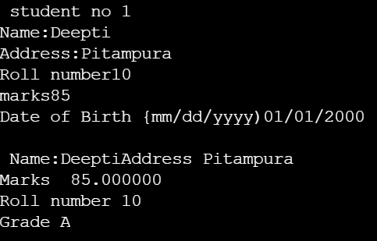

Slide 18
Structure and Pointer
The data members of functions can also be accessed through pointers.
#include <string.h>
struct student
{
int id;
char name[30];
float percentage;
};
void main()
{
int i;
struct student record1 = {1, "Raju", 90.5};
struct student *ptr;
ptr = &record1;
printf("Records of STUDENT1: \n");
printf(" Id is: %d \n", ptr->id);
printf(" Name is: %s \n", ptr->name);
printf(" Percentage is: %f \n\n", ptr->percentage);
}

Slide 19
Passing structure by reference
The memory address of a structure variable is passed to function while passing it by reference.
If structure is passed by reference, changes made to the structure variable inside function definition reflects in the originally passed structure variable.
#include <string.h>
struct student {
int id;
char name[20]; float percentage;
};
void func(struct student *record);
void main() {
struct student record;
record.id=1;
strcpy(record.name, "Raju");
record.percentage = 86.5;
func(&record); }
void func(struct student *record) {
printf(" Id is: %d \n", record->id);
printf(" Name is: %s \n", record->name);
printf(" Percentage is: %f \n", record->percentage); }

Slide 20
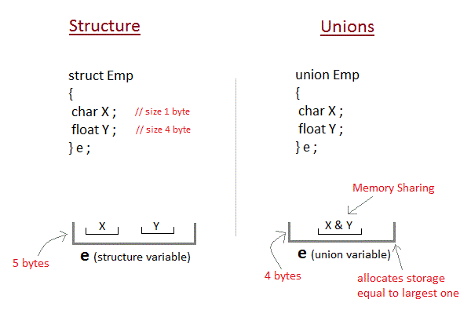
Union
Unions are conceptually similar to structures. The syntax of union is also similar to that of structure.
The only differences is in terms of storage.
In structure each member has its own storage location, whereas all members of union uses a single shared memory location which is equal to the size of its largest data member.

Slide 21
Example
union Data {
int i;
float f;
char str[20];
};
int main( ) {
union Data data;
printf( "Memory size occupied by data : %d\n", sizeof(data));
return 0;
}

Slide 22
Accessing a Union Member
Syntax for accessing union member is similar to accessing structure member,
union test
{
int a;
float b;
char c;
}t;
t.a ; //to access members of union t
t.b ;
t.c ;

Slide 23
